Slide 1
Chuck Berger Crossfire’s Building Advanced Websites Class Project

Slide 2
Overview
With the course not being what was expected (learning about tools to create websites), and instead focusing on building websites from the ground up including of all of the syntax nuts and bolts behind doing so, I found myself behind the 8 ball in the first few weeks. Without the mentality or experience of a programmer, I saw value and returned week after week despite falling further and further behind and becoming more intimidated.
However, against odds, I was determined to somehow present a project, regardless of missing elements and paling by comparison to my gifted and talented classmates who were probably more aware of what they were signing up for. After 17 weeks of 2 hour travel each way, I had to product something!

Slide 3
But Where to Begin??
With the prior stated permission of the teachers when discussing the project contest rules, I decided that I would create a trumpet shop (not that I don’t like guitars) being a trumpet player since 3rd grade and miss playing as an adult (only about once per year now).
Lost on how to begin, with class files and the VM becoming more of a mess each week, I decided to go on a searching safari for a “template” for a home page with some CSS where I would be comfortable with the basic layout and feel. Eventually, I found one. I started with it and then changed almost every aspect of it’s appearance and then added more pages until I nearly forgot I started with a template instead of from scratch.

Slide 4
What I Did cont’d
The changes to the “template” included:
HTML 5 declaration
Endless iterations of CSS files manipulation to accomplish my desired “look and feel”
Background(s) (including positioning, image repeat, margins, etc.)
Images
Nav Bar appearance, style and links
Other links
Fonts (sizes, colors)
Black vertical band to help appearance of background and right margin
Email contact link to interphase with email client
Footnote
News area
Embedded Audio and Video tested and tweaked for Firefox and Chrome (IE was a bear). Make it user friendly and not annoying
Wordpress Blog page

Slide 5
What I Did cont’d
During the initial process, decisions had to be made to move along and minimize frustration. This included:
Moving the building of the project OUTSIDE of the VM as the environment had begun to move extremely slowly and would not render things properly in Chromium OR Eclipse.
At this late stage, concern myself with what I could do and not focus on what I couldn’t or haven’t grasped.

Slide 6
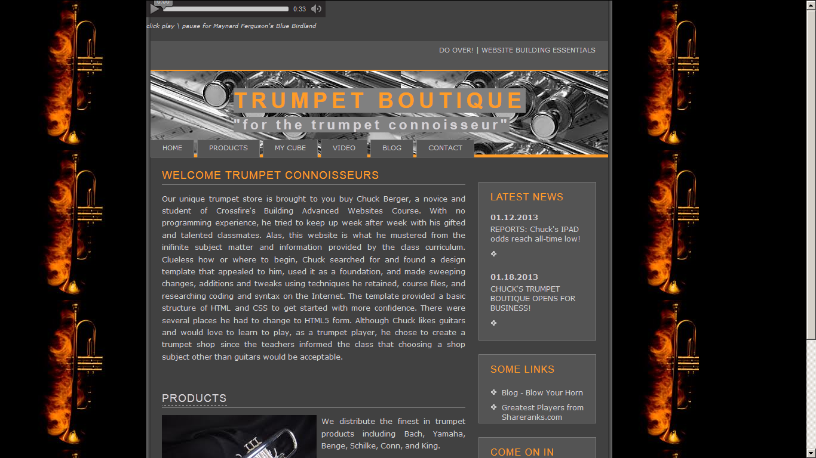

Slide 7
Challenges (other than the obvious one of being me)
The template I found may not have been the best technical foundation as it didn’t contain many things that I morphed and changed (pictures, background, audio, etc.). But it had some structure and appearance that I did like so I pressed on.
Setting the background image repeating and looking “balanced”. This was very different than Homer’s bats which can be unbalanced without looking bad. Incorporating this setting the foreground with my logo (valves picture) was even more challenging.
Margins and Padding - Never really understood them until I had to play with them! I went through countless iterations before rendering what I wanted which included adding a black vertical strip I created so the background would render what I wanted by being covered by the black strip.
The Cube - OY THE CUBE! I never got Homer’s working but I was determined to get something working on my project. Found some online instructions about a 3D rotating cube. Spent hours trying to figure out how to get it the way I wanted through many iterations that wouldn’t render right. My 3 pictures (flames, valves, and silver) on the 6 sided cube would end up on top of each other or same pic next to each other. I wanted each pic to be opposite it’s twin. I also wanted the pictures to retain some transparency too as it looks cooler that way.

Slide 8
Challenges, cont’d
Embedded Audio (and Video) – originally I did it in an older method than HTML5. It didn’t work well in all browsers and didn’t behave predictably. Finally, when I changed it to an HTML5 method, worked great in both browsers and I gave the users the option to play it manually or not, rather than have it auto-play on loading. I really liked the difference! It also included play\pause, mute in Firefox, and in Chrome volume control!
GitHub - Oh no. But wait! I discovered and installed Github for Windows. What a pleasure and easy to use! Almost auto-magical synchronizing. Everything verified on the Gighub.com. Great!
PHP – I tried so many things. XAMPP, WAMP, Cloud based Xeround to get my PHPMyAdmin database connected. No matter what I did I couldn’t establish a connection with PHP files from a browser to my trumpetshop database which I setup no problem both locally and in Xeround.
Mobile and Mobile App – just too much information to absorb so quickly. Had no idea how to begin to make the PC centric site a mobile site. However, I would have made a simple mobile site that contained the audio, the products page and all of the different “contact us” methods to reach the store. The app would have contained all of that plus directions to the store and weekly notifications of all store specials and new arrivals.

Slide 9
My Site Pages
index.html – trumpet boutique home page
products.html – examples of products
mycube.html – a page demo of the rotating cube images
video.html – a separate page housing embedded video
cberger19.wordpress.com – live trumpet boutique store blog
For what would have been php pages connecting to phpmyadmin database, I will show my xeround.com phpmyadmin database table and a simple mysql query inside phpmyadmin on xeround.
There are 3 different CSS files used for the 5 pages

Slide 10
THANK YOU ALL! & Thanks to Crossfire staff for offering this opportunity! & one more thing…

Slide 11
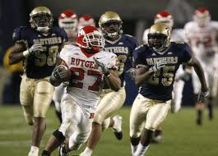
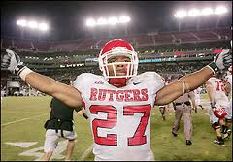
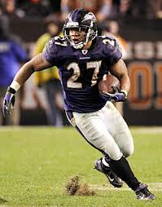
GO RAY AND GO RAVENS!

